Slide 1

From short-term implementation to transition pathways:
SUMP PLUS concepts/tools
Peter Jones
Centre for Transport Studies, UCL
Planning for sustainable mobility in small cities
Notes:
1

Slide 2
Overview
SUMPs (Sustainable Urban Mobility Plans) provide a sound basis for urban mobility planning and for securing national and international funding
SUMP-PLUS supports this process, by:
  Developing a broad city vision
  Extending the timescale – towards a long-term transition pathway
  Broadening the base: working with other sectors, to achieve zero carbon and other policy objectives
  Providing sets of simplified tools, for small cities
Planning for sustainable mobility in small cities

Slide 3
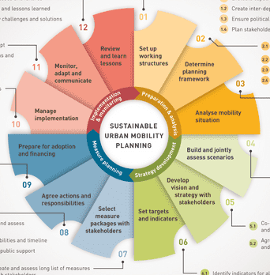
SUMP PLUS for small cities
2. TRANSITION PATHWAY
1. CITY VISION
3. CROSS-SECTOR LINKS
4. SUMP-PLUS TOOLS
Planning for sustainable mobility in small cities

Slide 4
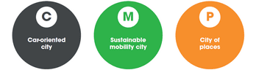
1. City visions change over time
Roads for sustainable transport
Roads for cars
Streets for people
Planning for sustainable mobility in small cities

Slide 5
Roads -> Streets
Two-dimensional street classification:
M: Movement
P: Place
Planning for sustainable mobility in small cities

Slide 6
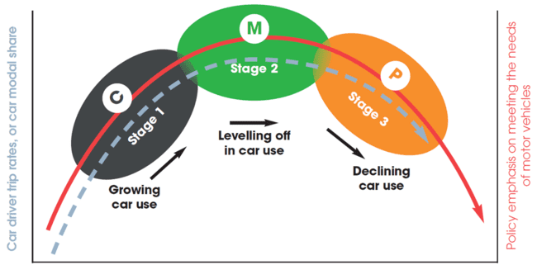
Visions affect levels of car use
Planning for sustainable mobility in small cities

Slide 7
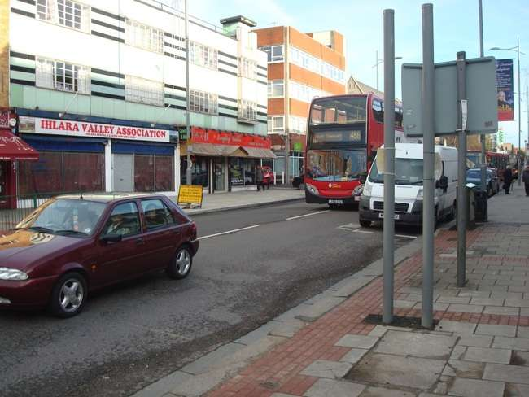
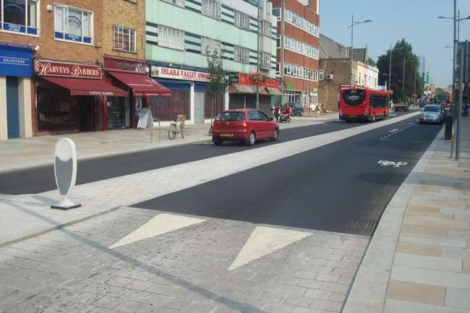
Effect of different design priorities
Before (C) – Road After (P) - Street

Slide 8
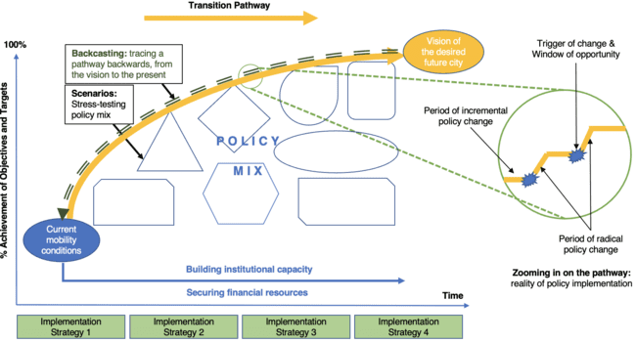
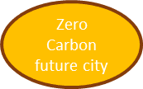
2. ‘Transition Pathways’ - long-term challenges
SUMP Cycle 1
SUMP Cycle 2
SUMP Cycle 3
SUMP Cycle 4
Planning for sustainable mobility in small cities

Slide 9
3. Links: who can deliver what?
AVOID:
Substitute digital for physical meetings
Provide equipment in-home
Localise facility provision (shorter trips)
SHIFT:
Support/encourage shift to sustainable modes
Consolidation of freight
IMPROVE:
Decarbonisation of vehicle fleet
Increase energy efficiency
Trip-generating sectors: education, health, leisure, retail..
Governments, transport providers, major trip attractors
Industry, utilities and transport providers
Planning for sustainable mobility in small cities

Slide 10
Role of the tourist sector
Each activity generates travel: tourists, employees and freight
Day Visitors
Overnight Visitors
Accommodation
T O U R I S T A T T R A C T I O N S
Cafes & Restaurants
Tourist-related retail
Entertainment
Healthcare facilities
Car rental & repair facilities
Planning for sustainable mobility in small cities

Slide 11
4. Simplified tools for small cities
Large cities have in-house skills to develop their SUMP, which smaller cities don’t have
Employing external consultants addresses the problem, but often results in a ‘report on the shelf’
SUMP-PLUS simplified (open source) tools help city staff to get more actively involved – 2 examples….
Planning for sustainable mobility in small cities

Slide 12
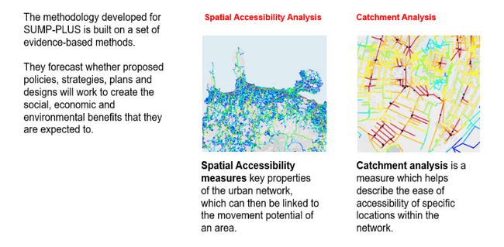
Spatial analysis (Space Syntax)
Planning for sustainable mobility in small cities
Notes:
Final example looks at a more Rural area with higher Car driver mode share and longer trips.
Avoid accounts for relatively more reduction – each trip avoided is longer distance and more likely to be driven.
Shift benefits are almost entirely associated with PT (not walk/cycle).
Even with 10% modal shift, still need 20% of car fleet to be electric by 2030. Almost 100% by 2050.

Slide 13
Carbon zero pathways scenario tool (Vectos)
Planning for sustainable mobility in small cities
Notes:
Final example looks at a more Rural area with higher Car driver mode share and longer trips.
Avoid accounts for relatively more reduction – each trip avoided is longer distance and more likely to be driven.
Shift benefits are almost entirely associated with PT (not walk/cycle).
Even with 10% modal shift, still need 20% of car fleet to be electric by 2030. Almost 100% by 2050.

Slide 14
SUMP PLUS for small cities
2. TRANSITION PATHWAY
1. CITY VISION
3. CROSS-SECTOR LINKS
4. SUMP-PLUS TOOLS
Planning for sustainable mobility in small cities

Slide 15

Legal Disclaimer: The sole responsibility for the content of this presentation lies with the authors. It does not necessarily reflect the opinion of the European Union. The European Commission is not responsible for any use that may be made of the information contained therein. All images are provided by the respective partners (unless otherwise noted) and are approved for reproduction in this publication.
Thank you!
For more information, please contact:
peter.jones@ucl.ac.uk
l.tronca@ucl.ac.uk
Notes:
15

